Slide 1
Albany Police Department Quarterly Update Mar 9th-May 28th

Slide 2
Mission and Vision
MISSION STATEMENT
Develop our personnel to provide quality law enforcement services in an efficient manner that keeps the public trust while maintaining order in our community.
VISION STATEMENT
The Albany Police Department is recognized as a CALEA accredited law enforcement agency using innovative and contemporary law enforcement practices that strengthen our relationship in our community.

Slide 3
2019 Focus Points
Continue to interact with citizens to help keep our community safe
Focus on Part II crimes and quality of life concerns
Use all available resources to identify and arrest offenders
Continue to support various community organizations

Slide 4
Operational Update
19,713 Calls for service (Mar 9th-May 28th)
13,684 Citizen Calls
5,968 Officer Initiated Calls
Incident Data
Part I Crimes – 969
Part II Crimes – 1,345
708 Individuals Booked into DOCO Jail, accounting for 692 incidents
Traffic Accidents – 1,106
1 Fatalities
23 incidents DUI

Slide 5
Recruitment Status (41 total)
Seven officers graduated Police Academy in Mar. 2019; in the 2nd phase of FTO
14 Applicants
Four officers completed FTO program Apr. 2019 (graduated in Jan 2019)
Ten officers in week 7 of Police Academy; graduate in Jun. 2019
Six recruits hired for Jul. 2019 Police Academy

Slide 6
Recruitment Summary
Continuing to recruit from various areas in the Southeastern United States
Looking for POST-certified officers
Looking for potential candidates with life and work experience who understand how to interact with people
Diversity not only in race, but in skill and experience
Learning from other organizations in how to attract potential applicants (law enforcement and non-law enforcement)

Slide 7
Employee Concerns
Salary satisfaction
Supervisor satisfaction
Work conditions
Overall opportunities for advancement

Slide 8
Code Enforcement update
10 structures demolished by City and one by owner since 03/19
Five structures out for bid and 31 on demolition list since 03/19
1601 S. Slappey Blvd: Property owner has cut and removed overgrowth on property
1006 violations and calls for service have been closed from 03/01/19-05/22/19
Drafted a courtesy notice for owners of poorly maintained commercial properties; awaiting final approval to be mailed out.

Slide 9
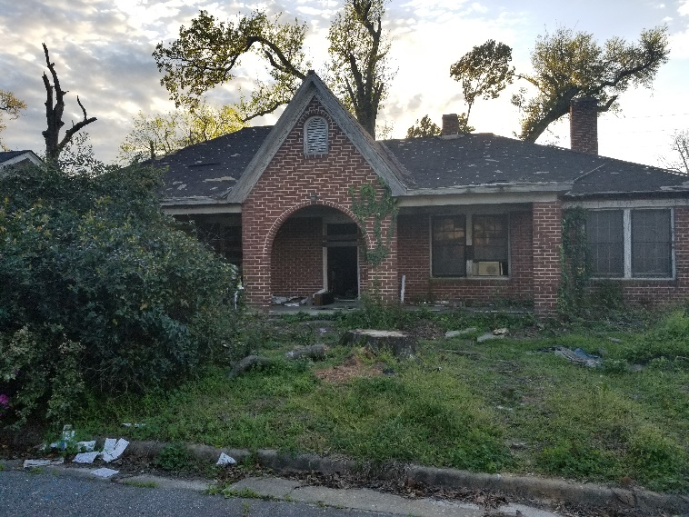
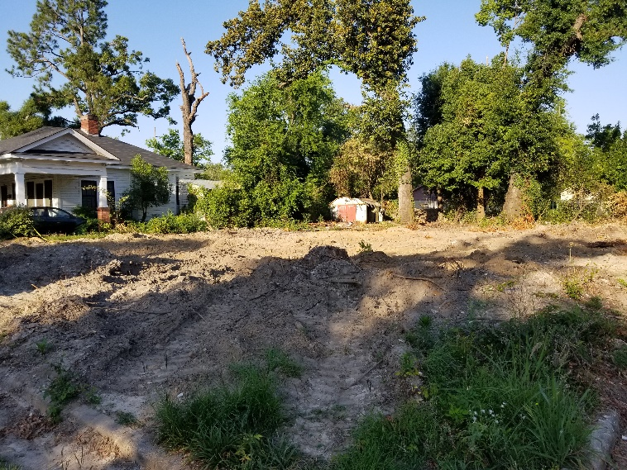
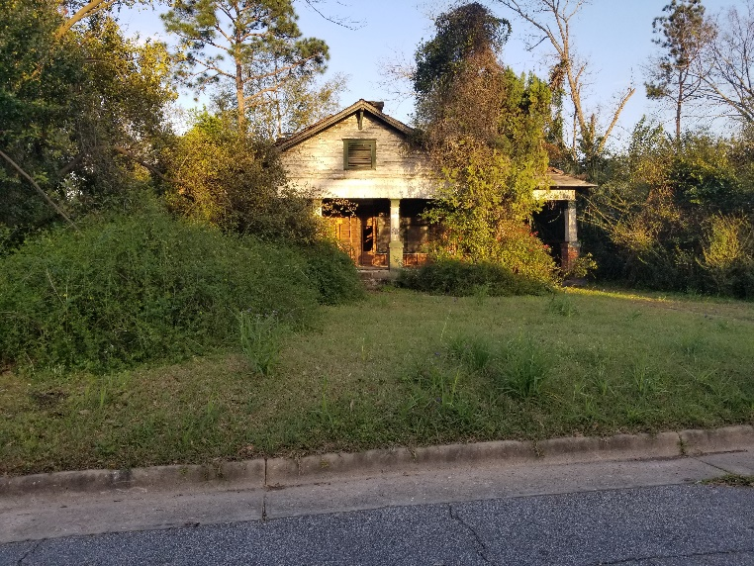
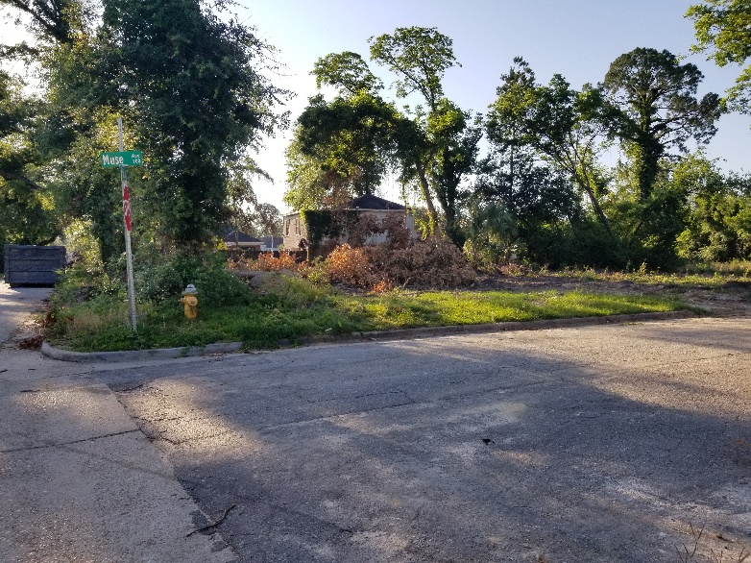
Code Enforcement efforts
Opportunities for development

Slide 10
National Incident Based Reporting System
FBI based reporting system; different than UCR
Increase to the number of incidents reported
More detailed, accurate and meaningful data
All Georgia agencies are required to participate by 10/01/19

Slide 11
What else have we done?
Seven arrested during probation and parole check in Albany
https://wfxl.com/news/local/seven-arrested-during-probation-and-parole-check-in-albany
Traffic stop leads to charges in Albany and Lee County
https://wfxl.com/news/local/traffic-stop-leads-to-charges-in-albany-and-lee-county
Albany PD officers recognized for service
https://www.walb.com/2019/05/07/albany-pd-officers-recognized-service/
Albany and Dougherty Co. honor local fallen officers
https://wfxl.com/news/local/albany-and-dougherty-county-celebrates-local-fallen-officers

Slide 12
Going Forward
Police Department Chaplains
Civilian Crime Scene Technician
Partnering with community groups on a summer project
Working with KADB in having a city-wide National Night Out event

Slide 13
Questions

