Slide 1
Albany Police Department Quarterly Update May 29th-Sept 8th

Slide 2
Mission and Vision
MISSION STATEMENT
Develop our personnel to provide quality law enforcement services in an efficient manner that keeps the public trust while maintaining order in our community.
VISION STATEMENT
The Albany Police Department is recognized as a CALEA accredited law enforcement agency using innovative and contemporary law enforcement practices that strengthen our relationship in our community.

Slide 3
2019 Focus Points
Continue to interact with citizens to help keep our community safe
Focus on Part II crimes and quality of life concerns
Use all available resources to identify and arrest offenders
Continue to support various community organizations

Slide 4
Operational Update
27,745 Calls for service (May 29th to Sept 8th)
17,824 Citizen Calls
6,921 Officer Initiated Calls
Incident Data
Part I Crimes – 1,325
E/A 204 reported incidents (169 non-forced/35 forced)
Part II Crimes – 1,911
990 Individuals Booked into DCJ, accounting for 1,091 incidents
101 Arrestees were booked into DCJ 2 or more times since May
Traffic Accidents – 1,269
1 Fatalities
35 incidents DUI

Slide 5
Recruitment Status (38 total)
Eight officers graduated Police Academy in Jun. 2019; in the 2nd phase of FTO
14 Applicants
Seven recruits in week 9 of Police Academy; graduate in Sept. 2019
Nine recruits hired for Oct. 2019 Police Academy

Slide 6
Recruitment Summary
Working with John Jay College of Criminal Justice in regards to potential applicants
Developed recruitment teams to attend various job and career fairs
Looking for POST-certified officers
Use outside resources to aid in recruitment (cost of living, location, etc.)
Variety of challenges that are affecting our recruits
Partnering with other agencies on a statewide study on recruitment and retention

Slide 7
Code Enforcement update
8 structures demolished by City, 1 by owner and 1 repaired by owner since 06/19
38 structures out for bid and 150 on demolition list since 06/19
805 violations and calls for service have been closed from 06/01/19 to 08/31/19
Conducted a “Sign Day” campaign with 417 signs recovered (06/21/19)
Mailed out 64 courtesy notices for owners of poorly maintained commercial properties (08/01/19)
Working with DCSO on addressing “set outs”

Slide 8
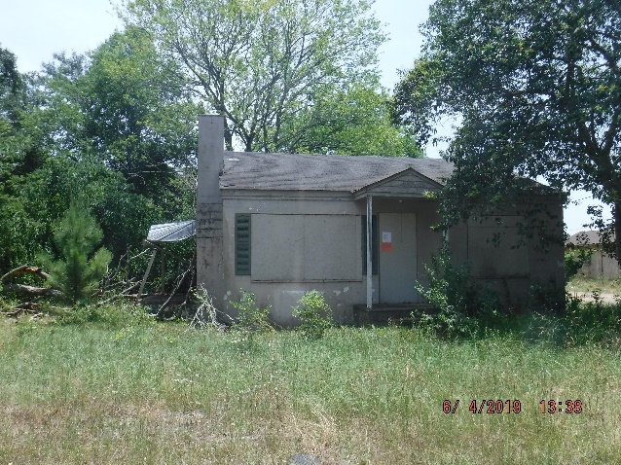
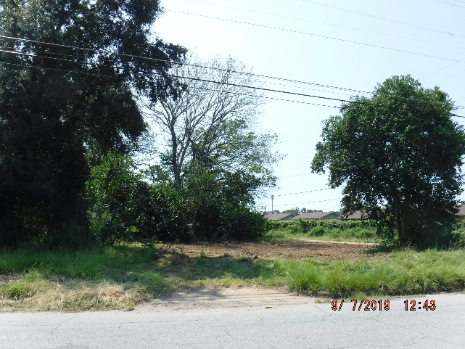
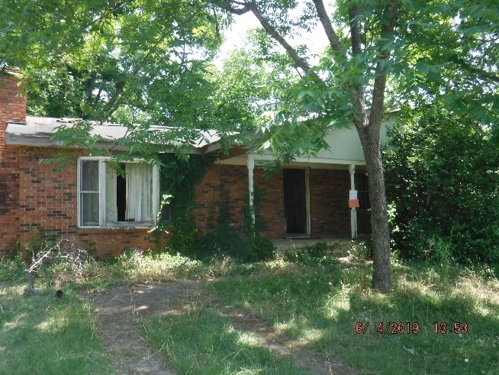
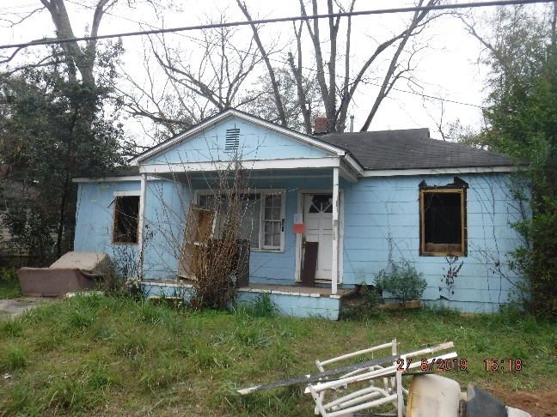
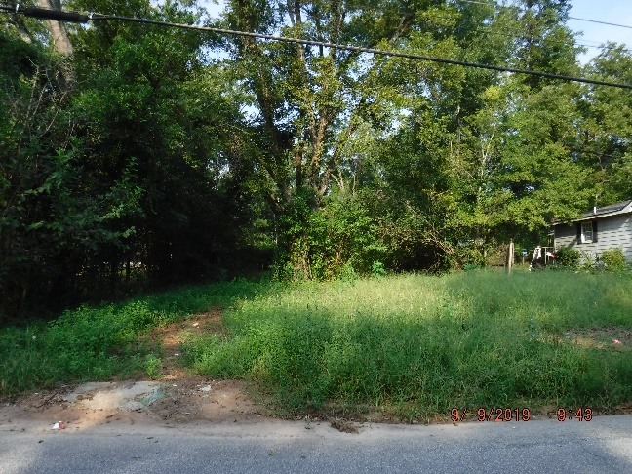
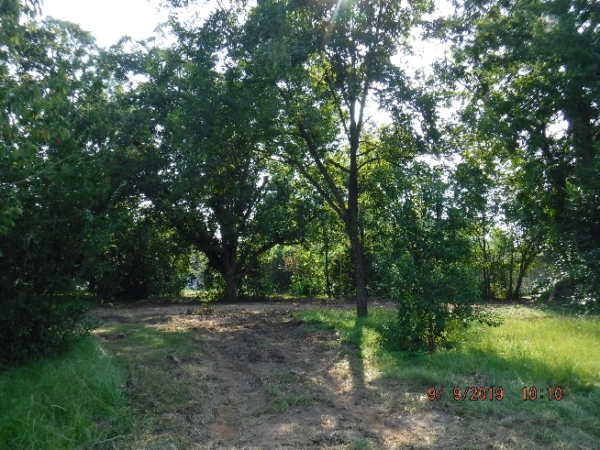
Opportunities for Development
114 Mitchell Ave..
1606 Elva St..
921 Rood St..

Slide 9
What else have we done?
City leaders and law enforcement come together for National Night Out
https://wfxl.com/news/local/city-leaders-and-law-enforcement-come-together-for-national-night-out
Project Safe Neighborhood programs have begun
Intervention and Counseling programs for youth
Graduated our first Middle School Teen Police Academy
Working with a faith-based organization on conflict resolution center

Slide 10
Going Forward
Volunteers to support police operations
Registration of video surveillance systems
Community Trust Initiative (IACP project)
GBI Southwest Regional Drug Enforcement Office (SWRDEO)
Planning for our Annual Thanksgiving Community Event

Slide 11
Questions

