Slide 1
VIRTUAL PUBLIC HEARING
CARES FUNDING & SUBSTANTIAL AMENDMENTS UPDATES FROM COMMUNITY PARTNERS FY 2020-2021 ANNUAL ACTION PLAN
June 1, 2020

Slide 2
HUD UPDATES
The Fiscal Year 2020-2021 Budget for HUD has been enacted and Entitlements and States have been provided funding allocations.
Special CDBG funding (CDBG-CV) has been provided to Entitlements (such as the City) and States under the Coronavirus Aid, Relief, and Economic Security Act (CARES) to respond to the public health crisis.
Program waivers have been granted by HUD to permit reprogramming of HOME funding to address housing needs of low-and-moderate income persons impacted by the coronavirus.

Slide 3
SUBSTANTIAL AMENDMENTS Community Development Block Grant (CDBG)
PROPOSED ACTIVITY | FISCAL YEAR |  | JUSTIFICATION
Demolition | FY 2018-2019 $15,000 | FY 2018-2019 $0 | Demolitions delayed
Commercial Facade | FY 2018-2019 $15,000 | FY 2018-2019 $0 | No applications received
Rehab Multifamily Units | FY 2018-2019 $133,497 | FY 2019-2020 $12,988 | Rental revenues were utilized
Section 3 Job Training | FY 2018-2019 $22,500 | FY 2019-2020 $5,627 | Funding was not expended by a subrecipient
Commercial Facade | FY 2019-2020 $0 | FY 2019-2020 $2,000 | One potential applicant
Flood Mitigation | FY 2019-2020 $0 | FY 2019-2020 $10,000 | Two homes will receive mitigation assistance
Commercial Rehab | FY 2019-2020 $25,000 | FY 2019-2020 $0 | Funding decreases required reprogramming
CARES Act Funding | FY 2019-2020 $0 | FY 2019-2020 $523,987 | Special funding to assist with emergencies and priorities of COVID-19 impacted, low-and moderate-income persons and businesses

Slide 4
PROPOSED CDBG-CV
The City was awarded $523,987 in Special CDBG funding under the Coronavirus Aid, Relief, Economic and Security (CARES) Act.
CDBG funding priorities to benefit COVID-19 impacted, low to moderate income residents could include:
$150,000 - Direct rental assistance (subsistence payments) for up to 3 months
$350,000 - Assistance to small businesses to provide grants (as short-term gap assistance) for up to 3 months
$23,987 - Public services such as food assistance (distribution and delivery) to seniors, disabled persons, and other priority populations.

Slide 5
SUBSTANTIAL AMENDMENTS HOME Investment Partnerships Program (HOME)
PROPOSED ACTIVITY | FISCAL YEAR |  | JUSTIFICATION
Acq/Rehab/HB | FY 2018-2019 $0 | FY 2018-2019 $75,000 | Acquisition of a single-family home
Downpayment Assistance | FY 2018-2019 $37,042 | FY 2018-2019 $13,000 | Less funding was utilized
Rental Rehab | FY 2018-2019 $282,384 | FY 2019-2020 $47,013 | Rental revenues were utilized
CHDO Set-aside | FY 2018-2019 $76,082 | FY 2019-2020 $0 | Reprogrammed funding for TBRA to assist with COVID-19
Acq/Rehab/HB | FY 2019-2020 $0 | FY 2019-2020 $50,000 | Acquisition of a single-family home
AHOP | FY 2019-2020 $0 | FY 2019-2020 $75,000 | Financing of a homebuyer unit
CHDO Operating | FY 2019-2020 $22,811 | FY 2019-2020 $0 | Reprogrammed funding for TBRA to assist with COVID-19
CHDO Set-aside | FY 2019-2020 $68,432 | FY 2019-2020 $0 | Reprogrammed funding for TBRA to assist with COVID-19

Slide 6
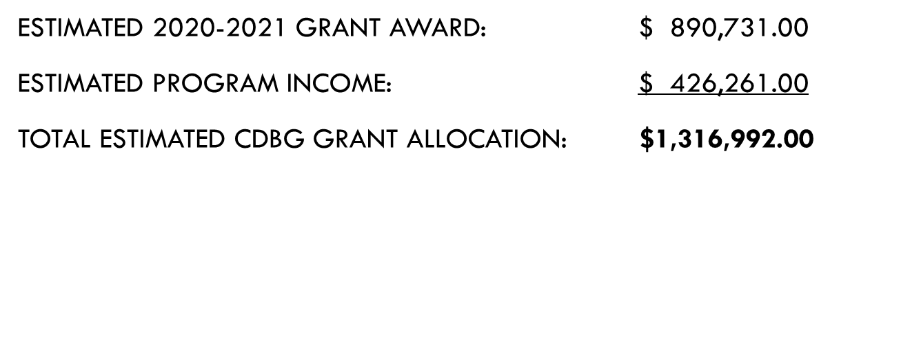
CDBG PROPOSED ACTIVITIES
FY 2020-2021

Slide 7
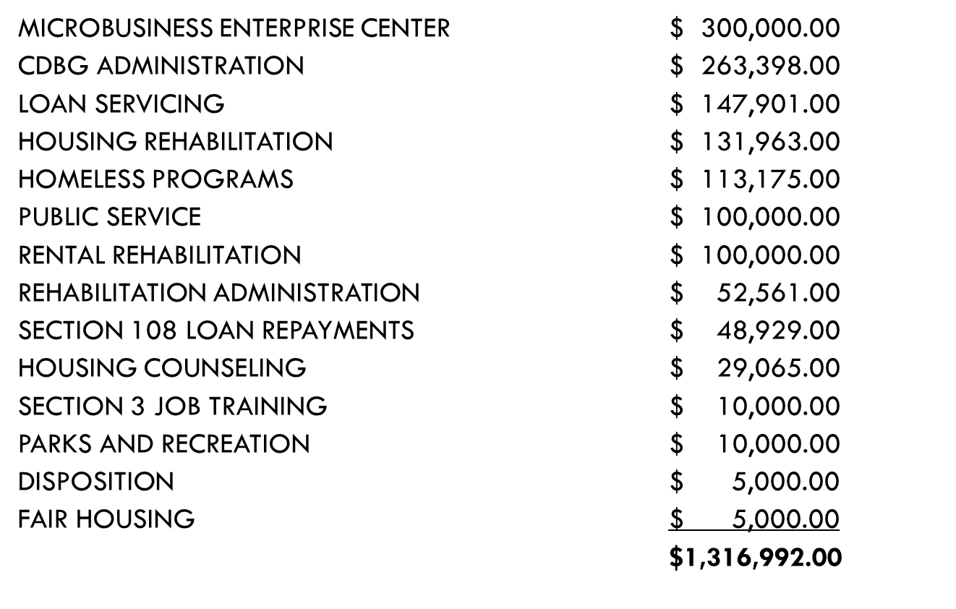
CDBG PROPOSED ACTIVITIES

Slide 8
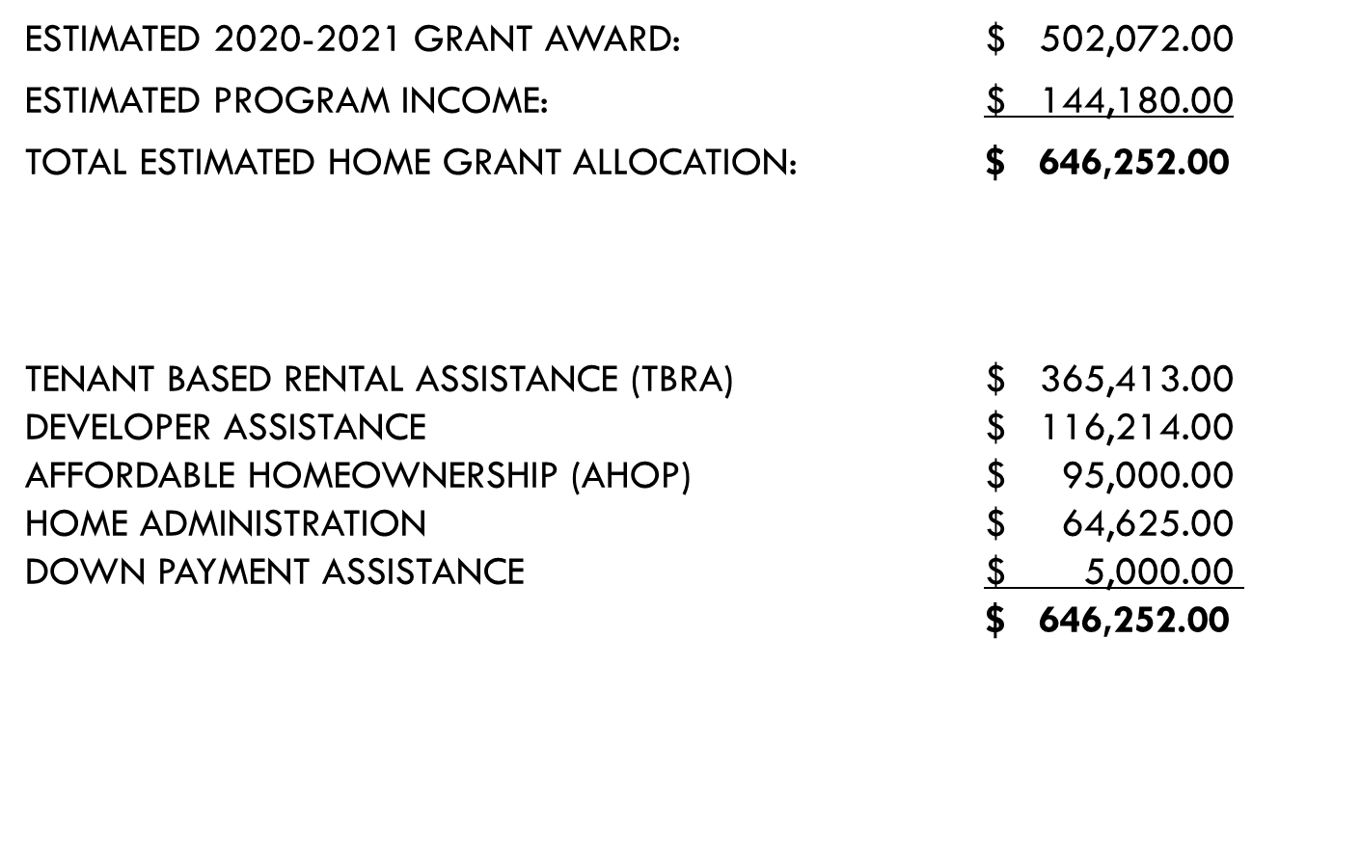
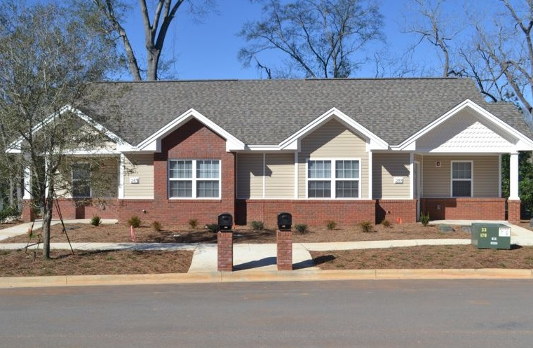
HOME PROPOSED ACTIVITIES
FY 2020-2021

Slide 9
2016-2021 Consolidated Plan Amendments
The Consolidated Plan results from a collaborative process in which the community establishes priority needs for housing, economic development, and community development activities with use of Community Development Block Grant (CDBG) and Home Investment Partnerships Program (HOME) funds.
The Plan will propose updates to:
Enterprise Neighborhood Revitalization Strategy Area (NRSA)
Urgent need initiatives/emergency services associated with the Coronavirus outbreak
Any priorities identified as a result of the community needs assessment

Slide 10
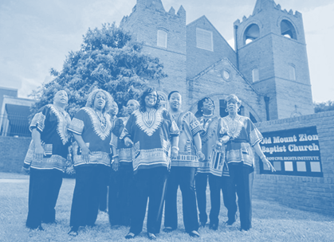
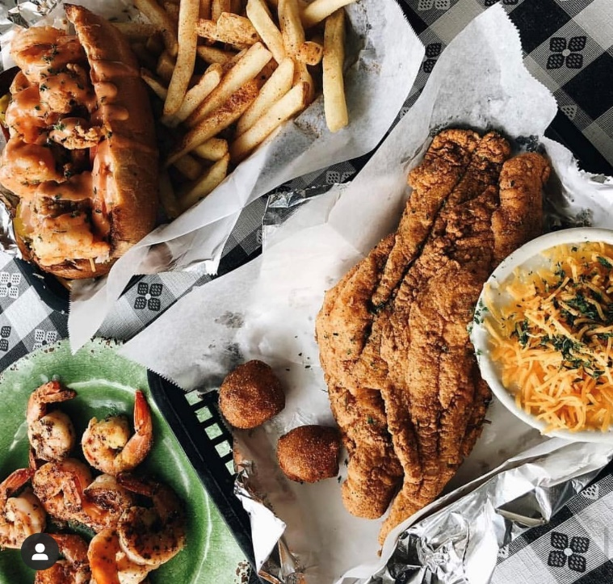
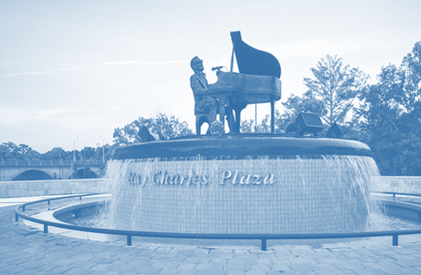

Slide 11
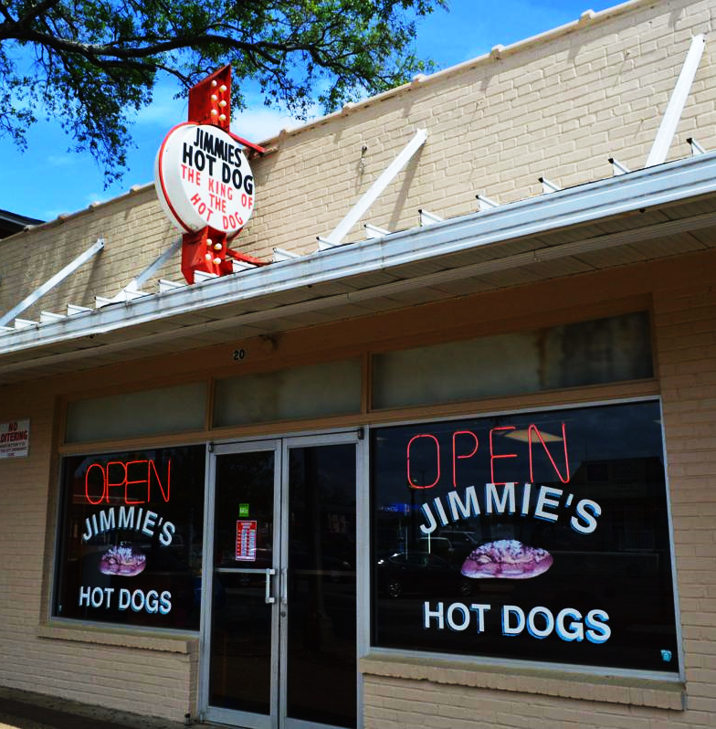
LOCAL ALBANY SMALL BUSINESS RELIEF PACKAGE (SBRP)
How much is it?
$2,500 to $10,000 for City of Albany businesses with annual gross receipts of $500,000 or less and up to 15 employees
Available Funds: $350,000 (CDBG minimum)+
Proposed $350,000 Match from City (Reserve Funds)
for a total of $700,000
Funds administered by Department of Community and Economic Development
GOAL: KEEP LOCAL SMALL BUSINESSES OPEN
Who is eligible?
LLC, S-Corps, Sole Proprietorship (nonprofits are not eligible)
Be in business within the city of Albany for 2+ years
Must also apply for CARES Act funding

Slide 12
LOCAL ALBANY SMALL BUSINESS RELIEF PROGRAM (SBRP)
Source of Funds
$350,000 – CDBG (minimum)
Community Development Block Grant
$350,000 – City Reserve Funds
GOAL: KEEP LOCAL SMALL BUSINESSES OPEN

Slide 13
LOCAL ALBANY “SMALL BUSINESS RELIEF PROGRAM” (SBRP)
How to apply?
Complete application
Applications/questions submitted to City of Albany Community and Economic Development
You will need?
Application
Current Business License
Georgia State Registration
W-9
Copy of invoice or statements from creditors to be paid with this funding
Proof of payments of property taxes, if applicable
If funds are to be used for payroll assistance three months of payroll registers will be required
GOAL: KEEP LOCAL SMALL BUSINESSES OPEN

Slide 14
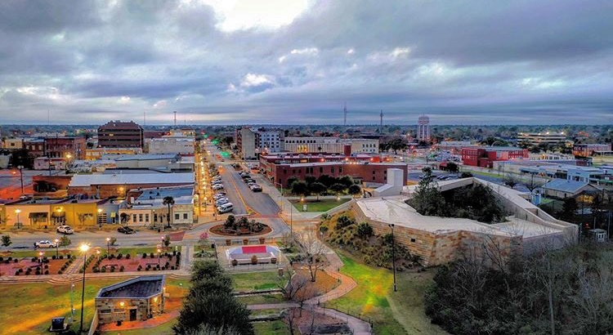
Local Albany-Small Business Relief Program Contacts
Phyllis Brown, Deputy Director of Dept. of Community & Economic Development
pbrown@albanyga.gov
(229) 302-1235
Barbara Francis, Economic Development Program Manager
bfrancis@albanyga.gov
(229) 302-1237

Slide 15
The Albany housing authority
Coronavirus Aid, Relief, and Economic Security Act (CARES ACT)

Slide 16
CARES ACT FUNDING
PREPARATION
PREVENTION
RESPONSE
PPE (Personal Protective Equipment)
Cleaning supplies to include sanitation stations, contract w/professional cleaning services, wipes, etc.
Communication Platform to provide residents with information quickly.
COVI19 Hazard Pay for Frontline Staff.
Support for Internal COVID19 Task Force.
Technology Integration (Management Software System to track, input, and analyze data)
Masks for Residents.
Virtual Educational and Informational Sessions for staff and residents.
Infrastructure Re-design
One-Stop Kiosk Systems and Computer centers
Transportation
Childcare

Slide 17
COVID-19 RESPONSE & RECOVERY
UNITED WAY OF SOUTHWEST GEORGIA

Slide 18
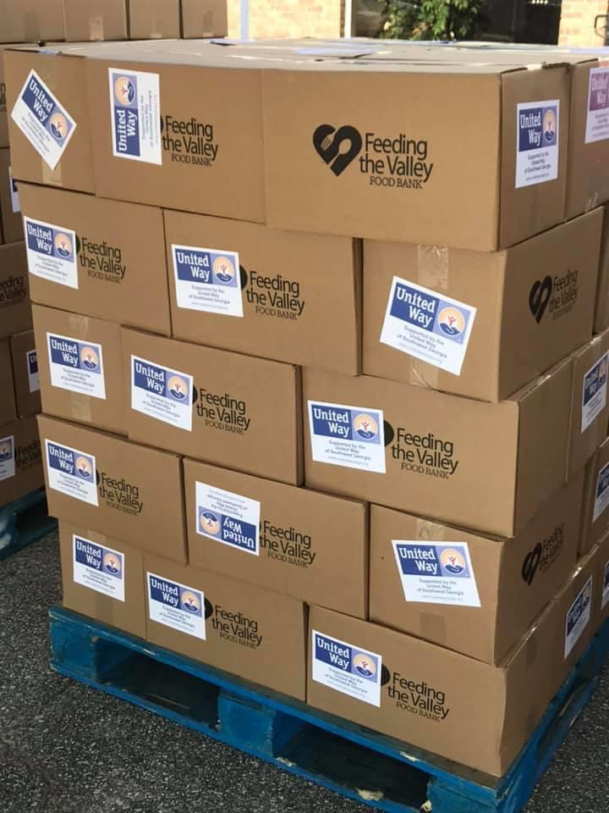
UNITED WAY’S COVID-19 RESPONSE
United Way is committed to standing with our communities and supporting those impacted by the COVID-19 outbreak.
We’ve activated the following resources/programs:
211. Get Help. Get Connected.
COVID-19 Community Relief Fund
EFSP COVID-19 Supplemental - Phase CARES
Neighbors Helping Neighbors Program
Nonprofit COVID Needs Assessment Survey
UNITED WAY OF SOUTHWEST GEORGIA

Slide 19
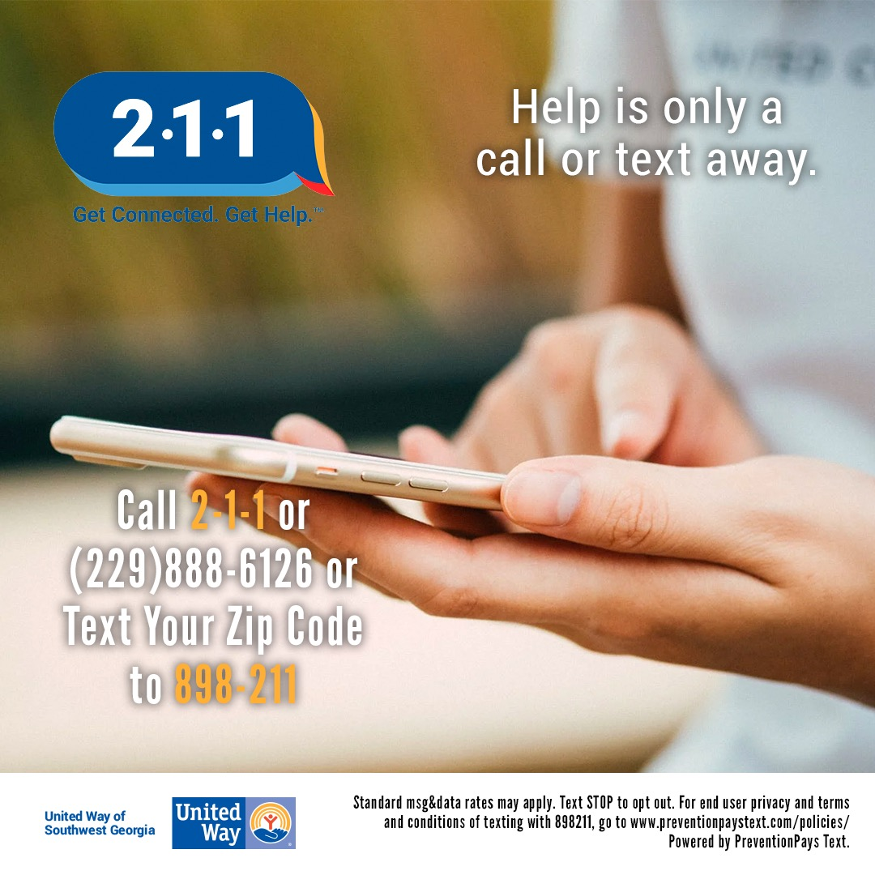
211, A SOCIAL SERVICES SUPPORT NETWORK
Since the onset of Covid-19, nearly 8,000 people have contacted our 2-1-1 helpline, a 941% increase over 2019.
Individuals can call or text to find help with:
emergency information and COVID-19 relief
health care and health epidemic information
supplemental food and nutrition programs
shelter and housing options and utilities assistance
support groups for individuals with mental illnesses or special needs
a safe, confidential path out of physical and/or emotional domestic abuse
UNITED WAY OF SOUTHWEST GEORGIA

Slide 20
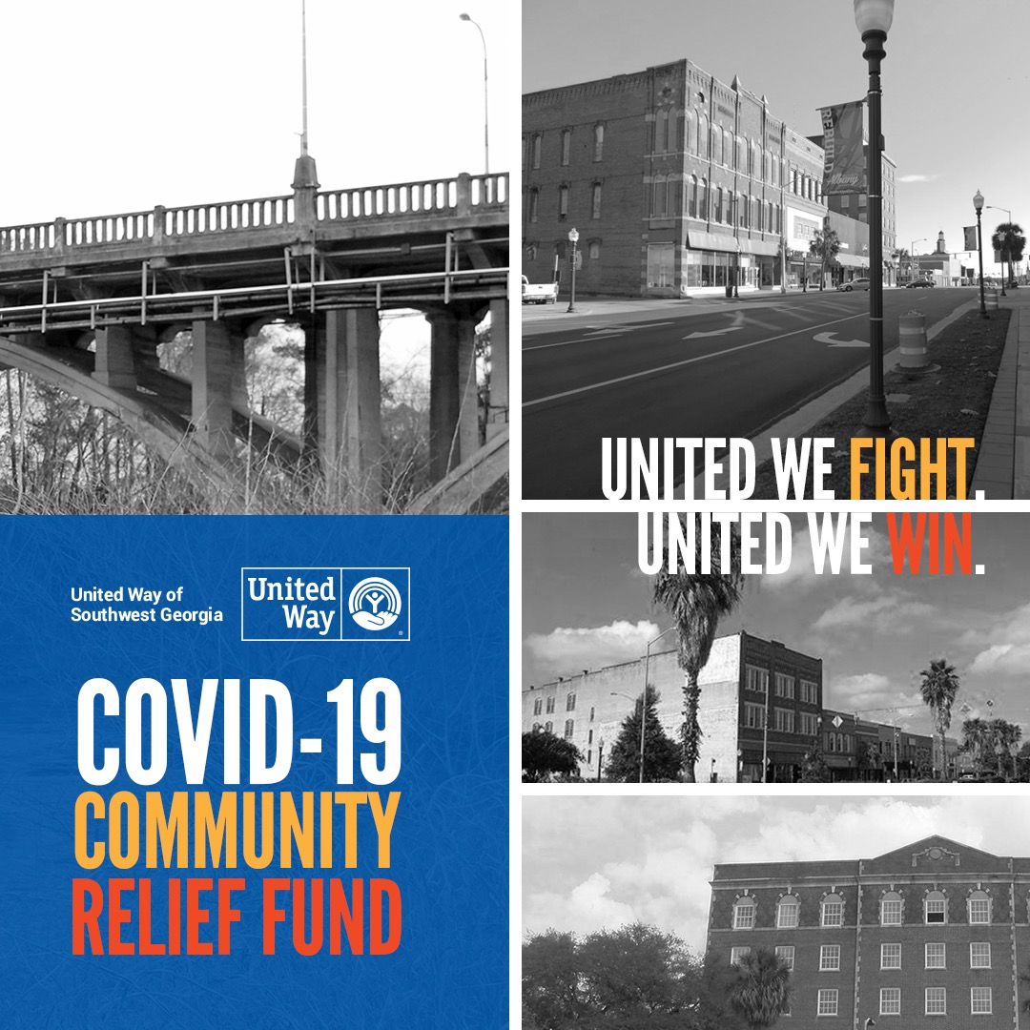
COVID-19 COMMUNITY
RELIEF FUND
Nearly $200,000 Awarded to 20 Organizations Addressing Our Community’s Most Basic Health & Safety Needs
Relief Fund Priority Areas:
Food access
Rent/mortgage/utility assistance
Emergency housing
Childcare for essential workers
Medical PPE for #MaskUpAlbany, DCSS & small businesses
Round Three Applications Due: Monday, June 8th
UNITED WAY OF SOUTHWEST GEORGIA
Notes:
Our team connects them with available resources to help them meet their immediate needs, and become stable.
We work with local and statewide partners to tackle the root causes of basic needs insecurity through policy changes and innovative community support programs.

Slide 21
COVID-19 RELIEF PARTNERS
UNITED WAY OF SOUTHWEST GEORGIA

Slide 22
CARES ACT
ASSESS
COUNSEL/COACH
ADVISE
REFER

Slide 23
CARES ACT
RENTAL
HOME RETENTION
FAIR HOUSING
FINANCE&BUDGET

Slide 24
CARES ACT
If you need to speak with a housing counselor, call 229-317-4745:
Patricia Fletcher-Edwards
HUD Certified Housing Counselor
Certified Financial Capabilies Coach
Certified Credit Coach
Email contact: BestLifeSkills@gmail.com

Slide 25
CITIZEN COMMENTS
All oral and written comments must be received by by 12:00 P.M. on Monday, June 8, 2020.
Email comments to gimills@albanyga.gov
Phone in comments to (229) 302-1251 (Between the hours of 9:00 a.m. and 4:00 p.m. Monday – Friday)
Mail comments to: City of Albany
Department of Community and Economic Development
230 South Jackson Street/Suite 315
Albany, Georgia 31701
You may access the FY 2020-2021 Annual Action Plan at the link below:
https://www.albanyga.gov/home/showdocument?id=6840

Slide 26
QUESTIONS/COMMENTS

Slide 27
THANK YOU FOR YOUR FEEDBACK!

