Slide 1

Albany Police Department Quarterly Update
Jan 1st-Aug 28th

Slide 2
Mission and Vision
MISSION STATEMENT
Develop our personnel to provide quality law enforcement services in an efficient manner that keeps the public trust while maintaining order in our community.
VISION STATEMENT
The Albany Police Department is recognized as a CALEA accredited law enforcement agency using innovative and contemporary law enforcement practices that strengthen our relationship in our community.

Slide 3
2020 Focus Points
Sustaining employee wellness
Addressing violent people, places and things
Continuing community engagement
Bolstering community trust

Slide 4
Operational Update
60,804 Calls for service (Jan 1st-Aug 28th)
  38,851 Citizen Calls; 21,953 Officer Initiated Calls
Incident Data
  NIBRS Group A: Crimes Against Person – 1,410
  NIBRS Group A: Crimes Against Property – 3,734
  NIBRS Group A: Crimes Against Society - 239
  NIBRS Group B: General Crimes – 1,612
  1,848 Individuals Booked into DCJ, accounting for 2,015 incidents
    290 Arrestees were booked into DCJ 2 or more times since January
Traffic Activity
  Accidents – 2,733
  6 Fatalities (1 pedestrian; 5 automobiles)
  83 incidents DUI
  6,076 citations; 3,084 warnings

Slide 5
Drug Enforcement Activity
ADDU
117 arrests
276 charges
Contraband seized: $1.2 million
Working in conjunction with local agencies within Do. Co.
SWRDEO
188 total cases
100 arrests
Contraband seized: $5.4 million
Investigations conducted in 27 counties in area of operation
32% of all cases originated in Do. Co.

Slide 6
Recruitment Status
(97 total)
Seven officers graduated Police Academy in Mar 2020; FTO complete
Nine officers graduated Police Academy in Jun 2020; in Week 7 of FTO program
Fifty-Six applicants to select for Jan 2021 Police Academy
Ten officers in the July 2020 Police Academy, currently in Week 8
56 Applicants
15 Recruits

Slide 7
Recruitment Summary
Increased interest since the pandemic occurred
Civil unrest and public sentiment towards law enforcement has hindered recruiting efforts
Looking for POST-certified officers; critiqued higher than others
Use outside resources to aid in recruitment (cost of living, location, etc.)

Slide 8
Campaign Zero
Ban Chokeholds & Strangleholds
Require De-Escalation
Require Warning Before Shooting
Require Exhausting all Alternatives Before Shooting
Duty to Intervene
Ban Shooting at Moving Vehicles
Require Comprehensive Reporting
Require Use of Force Continuum

Slide 9
Community Policing
Reimagine how we do public safety
Operational and Management Assessment of the PD
Input from the Community is needed (ex: APD Civilian Review Board)
How do we prepare the department for the needs of the community in the future?

Slide 10
What else have we done?
Code Ranger Program-15 participants
Civilian Crime Scene Technicians -2 personnel
Pastoral Police Academy
Mental Health and Substance Abuse partnerships (procedures)
Collective Impact Model with United Way for Youth

Slide 11
Going Forward
Need to maximize the use of technology
Continued partnerships with state and federal agencies
Moving towards the Community Trust Initiative with John Jay College
Community empowerment in the fight against crime

Slide 12
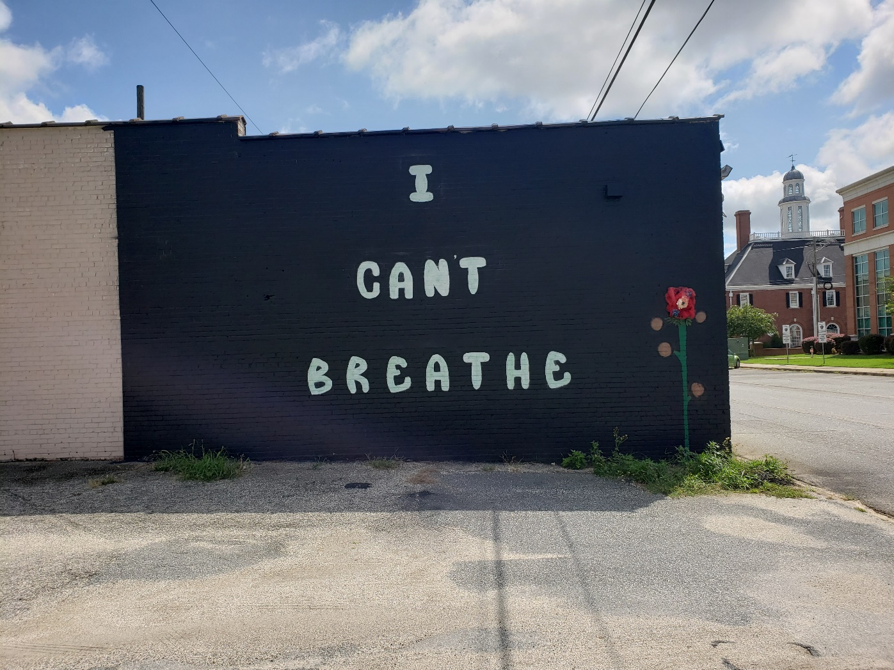
Questions

